Slide 1

Data is Beautiful
Tom Kelly: Quickfire SYSKA Oct 22nd 2015

Slide 2
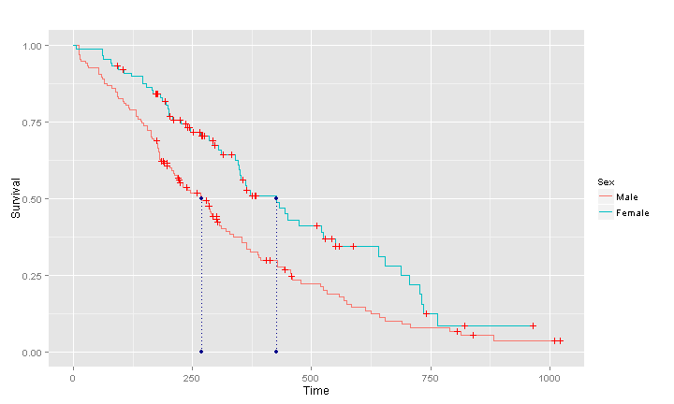
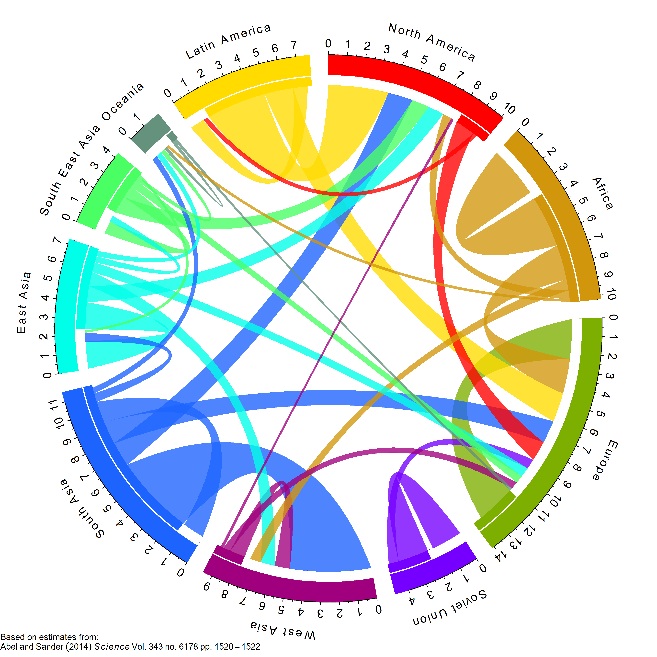
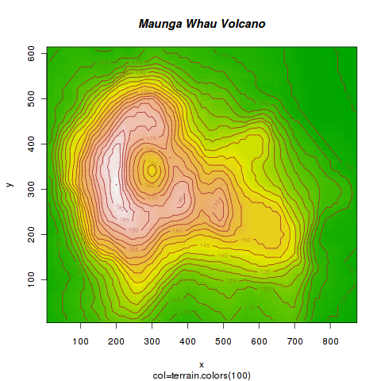
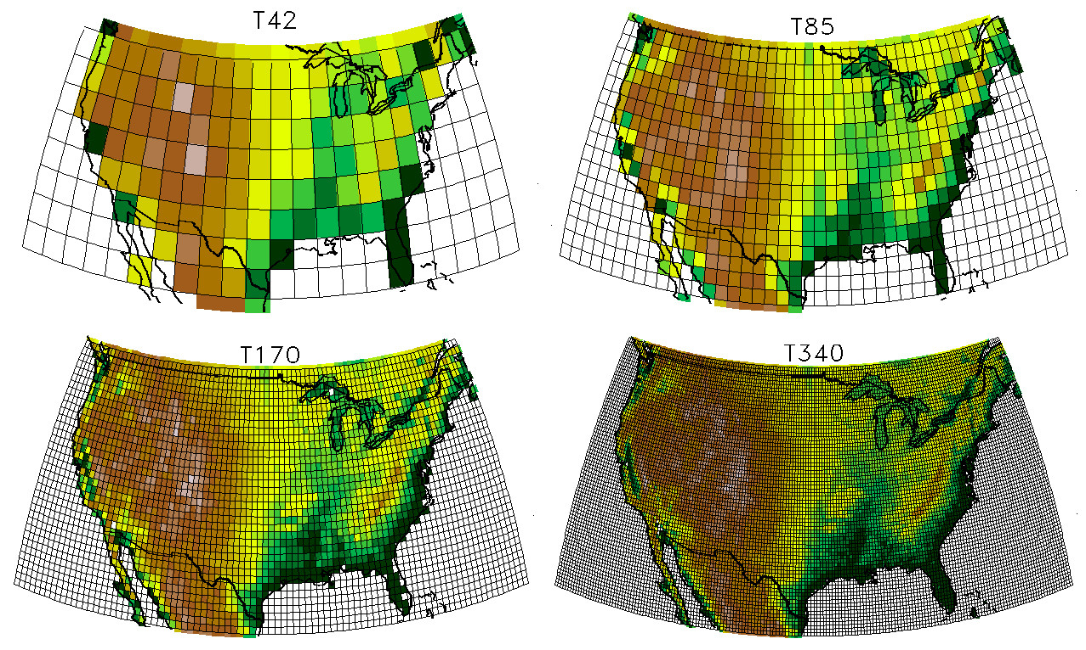
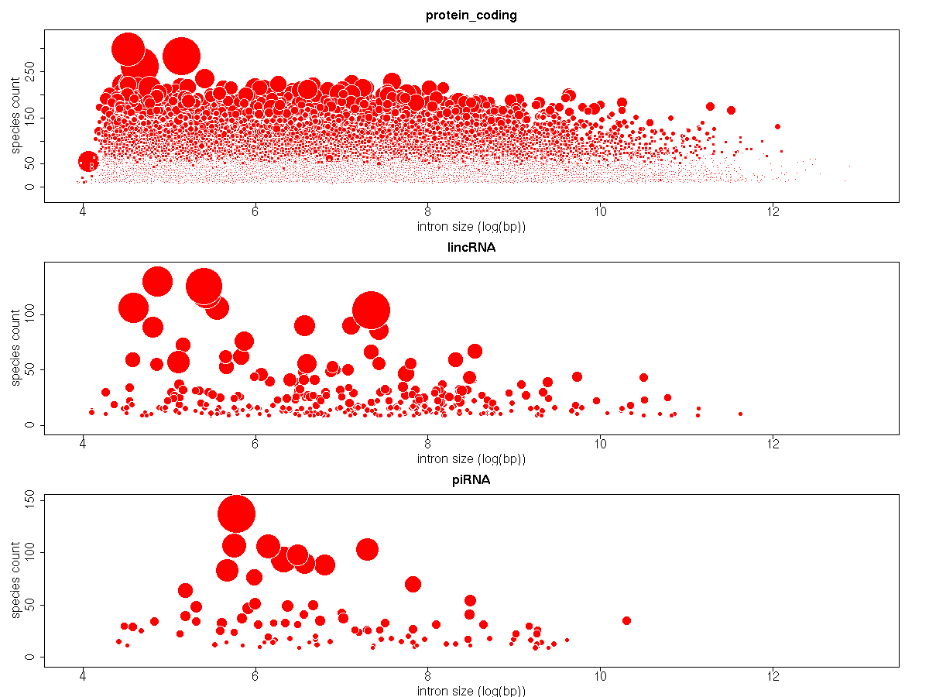
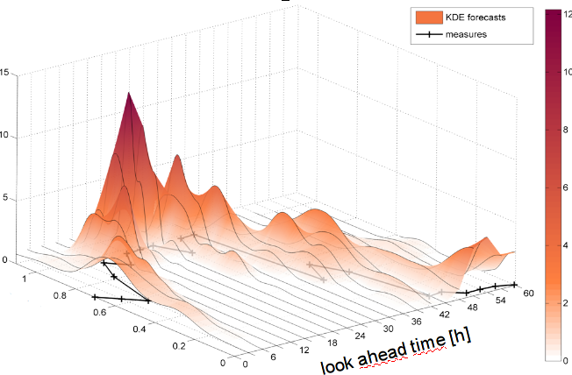
R is a powerful tool to visualise data

Slide 3
Visualising Data is Crucial to Research
Effective communication is essential in research
It helps us do better research and make better papers / theses
So think about it critically
Why Plot Data
Present Findings
Better Research
Interpret Analyse

Slide 4
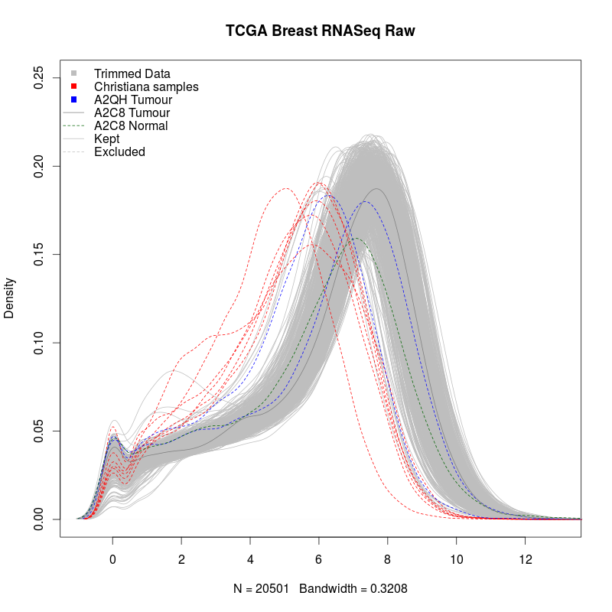
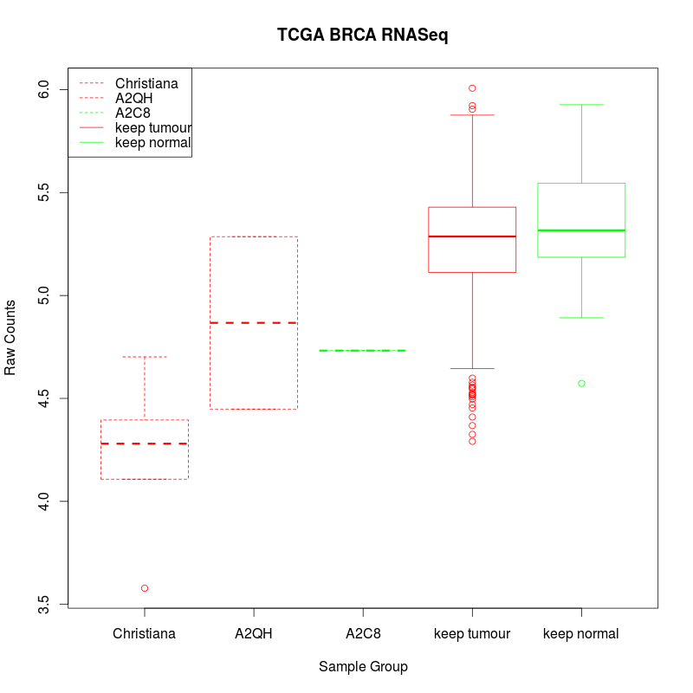
Use Visualisation to check data quality

Slide 5
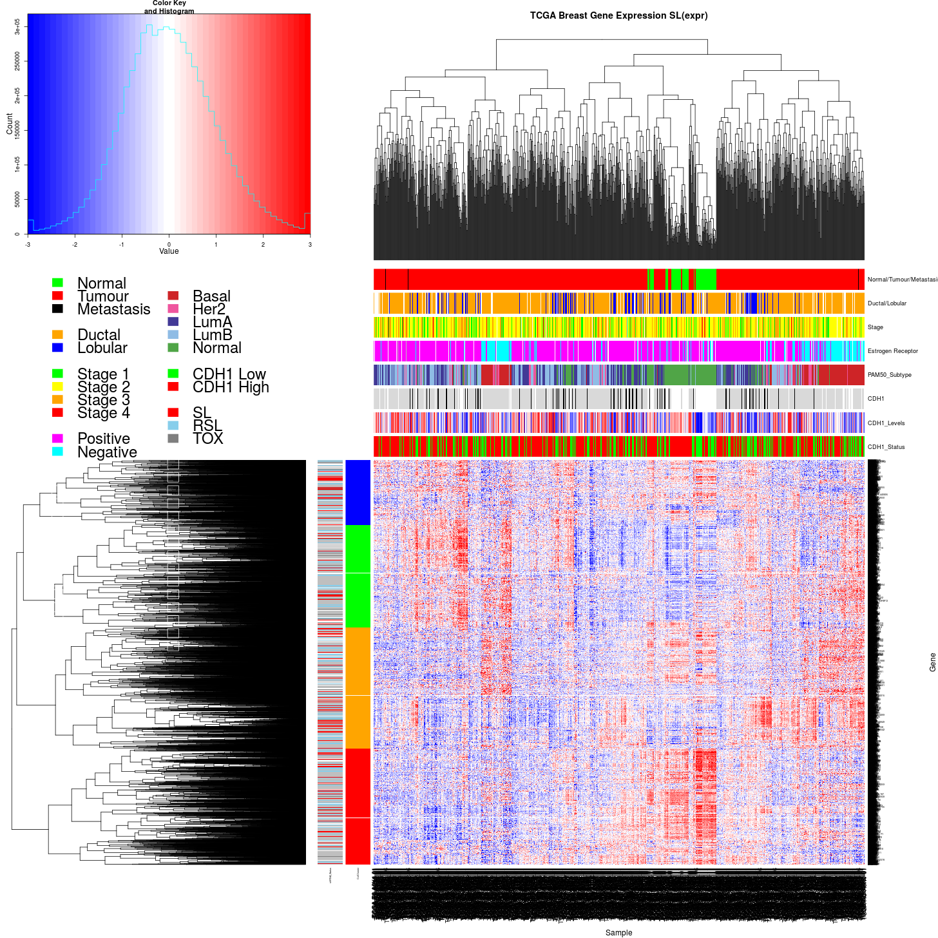
Heatmaps

Slide 6
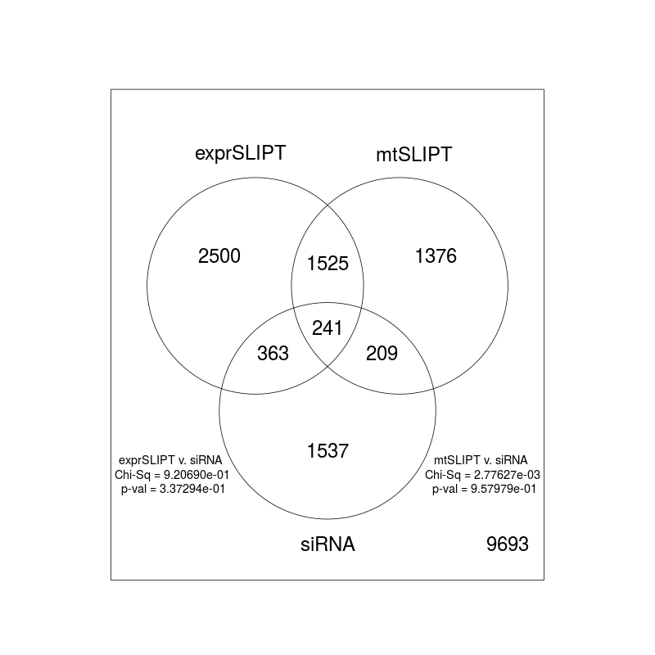
Venn Diagrams
3525
2901
Translation, non-sense mediated decay, SRP-dependent co-trans, RNA metabo, Immune, IFNγ, TLR, Chemokine, Gα(i), TCR, PD-1
Translation, non-sense mediated decay, SRP dependent cotrans, RNA Metab, secondary messenger, TCR, ZAP70, IGF, CD3, PD-1
604
450
GPCR ligand binding, GPCR (A/1), Chemokines, peptide-ligand bind, Gα(i), Gα(q), Platelet activation, Homeostasis, GPCR (B/2), Gα(z)
GPCR ligand bind, GPCR (A/1), NOTCH4, Platelet activation, GPCR (B/2), Circadian clock, Gα(i), Gα(s), Growth hormone R
1746
1900
GPCR (A/1), GPCR ligand binding, Gα(i), peptide-ligand bind, ion trans, Gα(q), purine receptor, phospholipase C, PI3K Cascade
GPCR (A/1), GPCR ligand bind, Gα(i), peptide-ligand, Gα(q), chemokines, Cyclin A/B1 (G2->M), GPCR (C/3), ion trans, Phospho C

Slide 7
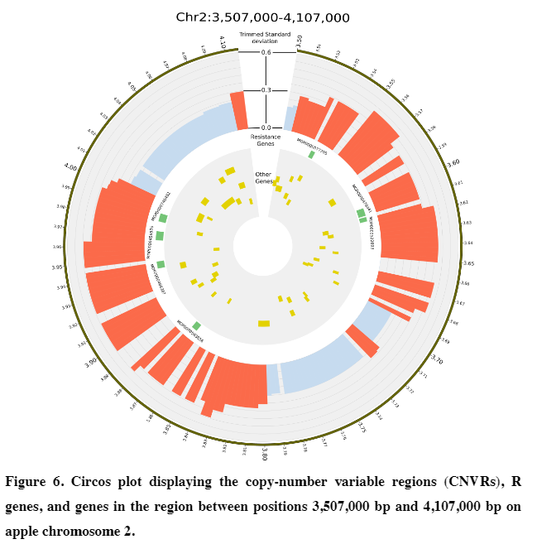
CirCos Plots
Boocock et al. (2015) BMC Genomics

Slide 8
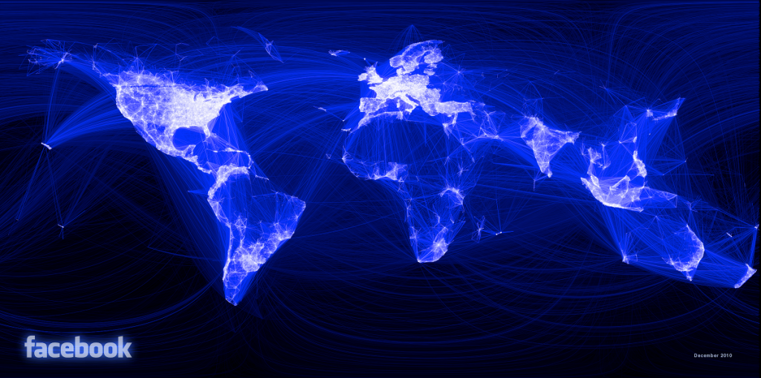
Facebook Map

Slide 9
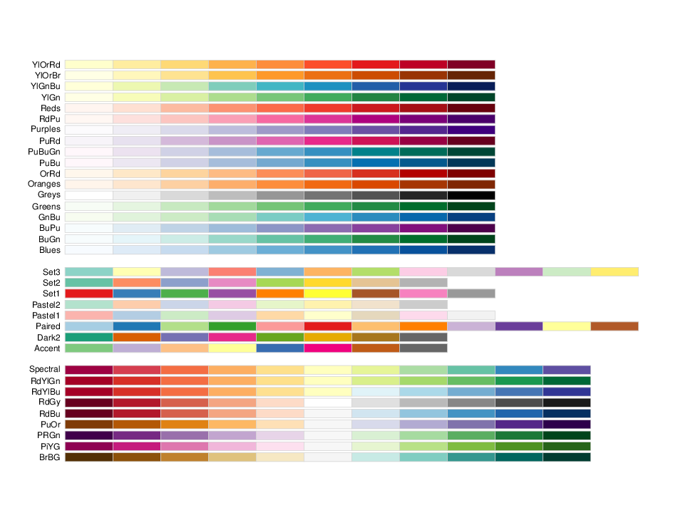
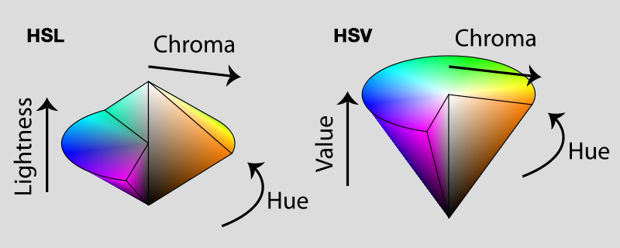
Colour
Colour Palettes:
Brewer Colours are based on perception research and colourblind-friendly
RColorBrewer package
https://www.nceas.ucsb.edu/~frazier/RSpatialGuides/colorPaletteCheatsheet.pdf
http://colorbrewer2.org/

Slide 10
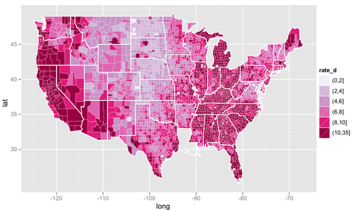
Colour

Slide 11
Visualising Data – Key Points
What to think about when plotting
Annotation Legends Readability Scale
Form Structure Whitespace Symmetry
Colours Appealling Colour-blindness

